Slide 1
Video Game Genre
Predicted from Console, Publisher, Regional Sales, and Release Year

Slide 2
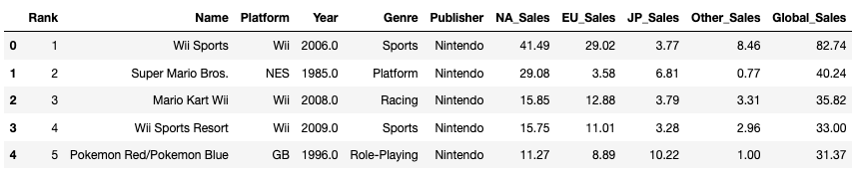
Categorical Features
Years - 40
Platforms - 31
Publishers - 579

Slide 3
eXtreme Gradient Boost
xgb.XGBClassifier(
n_estimators=30000,
max_depth=3,
objective="multi:softmax",
learning_rate=0.1,
subsample=1,
min_child_weight=1,
colsample_bytree=0.8,
num_class=12
)
Accuracy score on train dataset : 41.3%
Accuracy score on test dataset : 35.6%

Slide 4
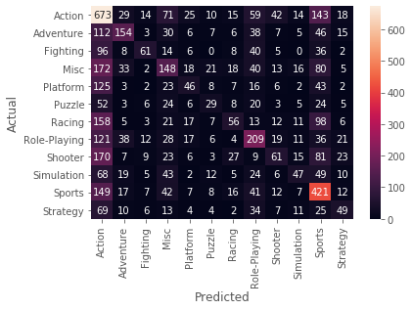
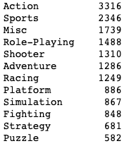
Imbalanced Classes

Slide 5
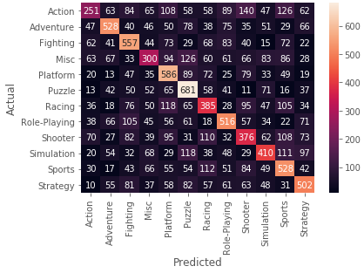
Random
Oversampled Classes
Accuracy score on train dataset : 48.1%
Accuracy score on test dataset : 42.7%

Slide 6





Slide 7
Resources and Visualizations
https://www.kaggle.com/gregorut/videogamesales
Tableau Public:
https://public.tableau.com/views/Project3_15887247909430/Dashboard1?:display_count=y&publish=yes&:origin=viz_share_link

